Slide 1

Computer and Tech Management System
Team Members:
Md. Shoaib Shahriar (190041233)
Protyoy Rafi (190041235)
Tahmid Rahman (190041237)
Sabry Said Sabry Ragab (190041243)

Slide 2
What is this project about?
This project aims to store information regarding various products of a computer hardware store as well as related information regarding the products.
Handles customer information, enables them to browse through a selection of products and purchase them.
The manager is given the full authority over the data.

Slide 3
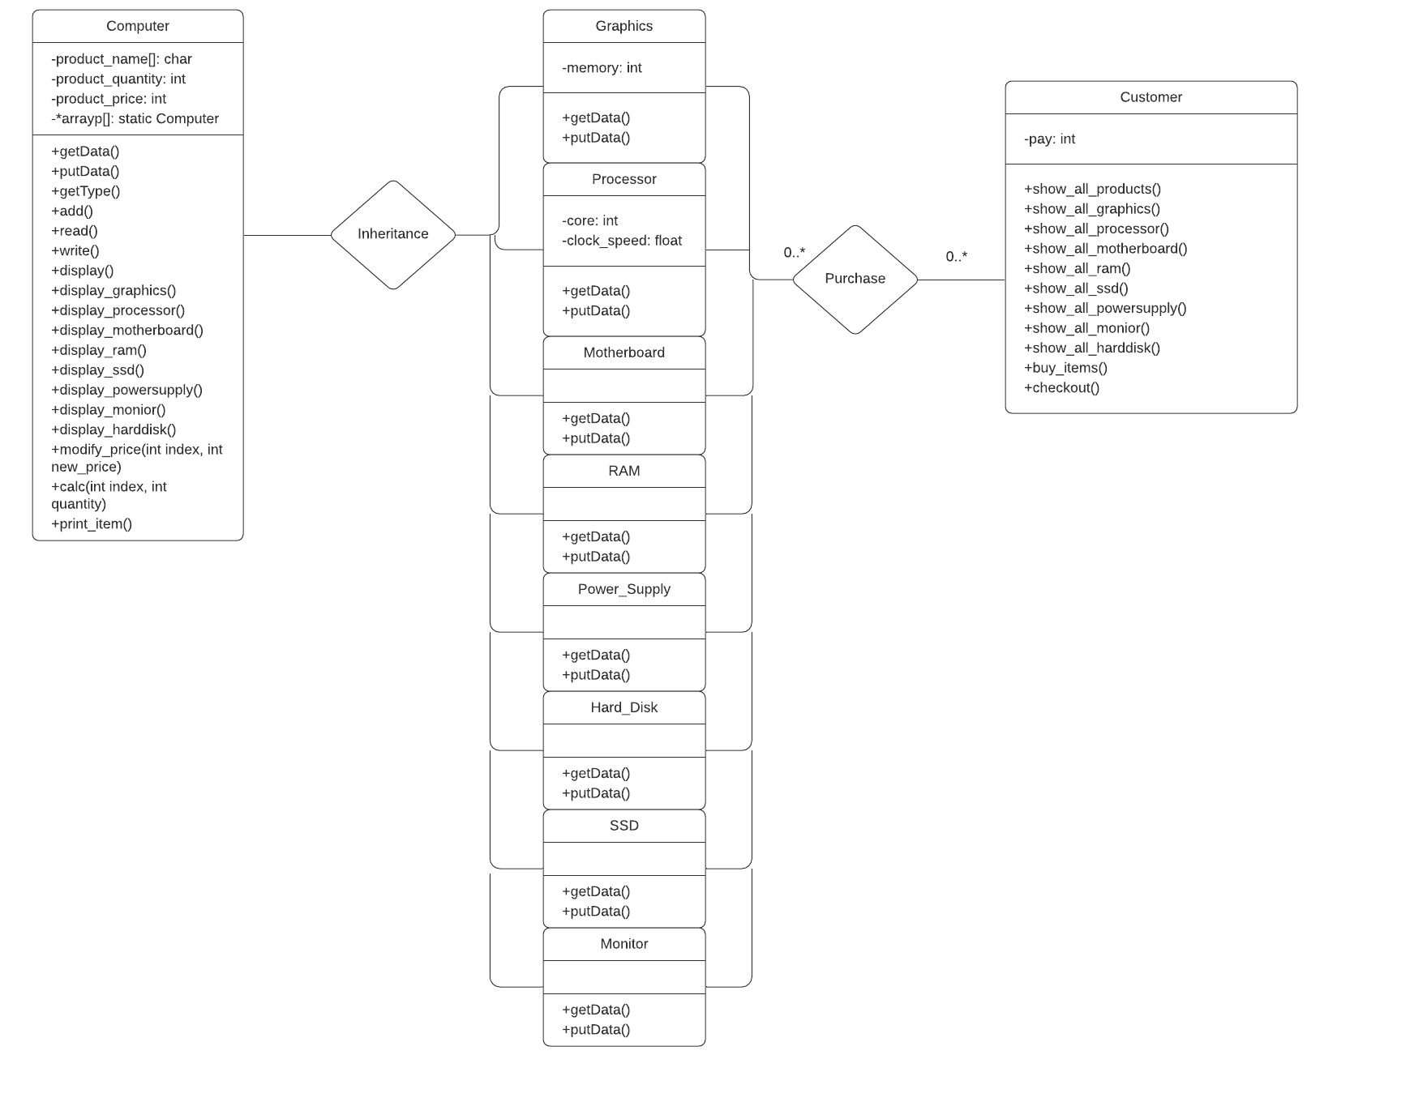
UML Diagram

Slide 4
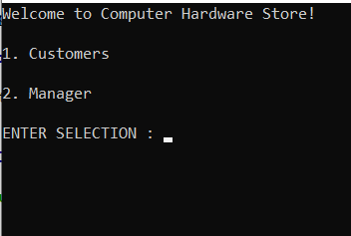
Functions and Features
The program has 2 types of user, one is for manager, the other is for customer.
The manager has the authority over the product data.
The access to manager section is password protected.
The customer can view products available and purchase from the available products.

Slide 5
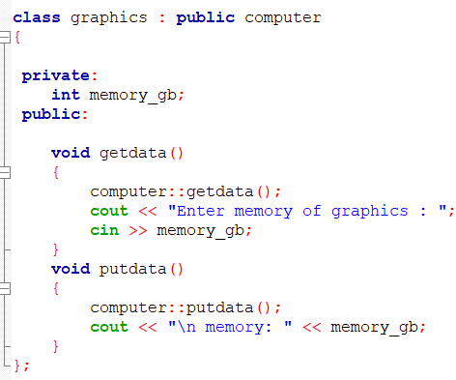
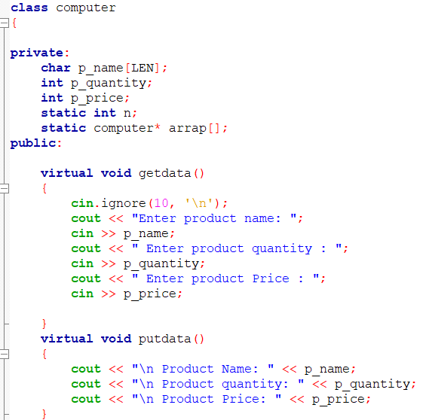
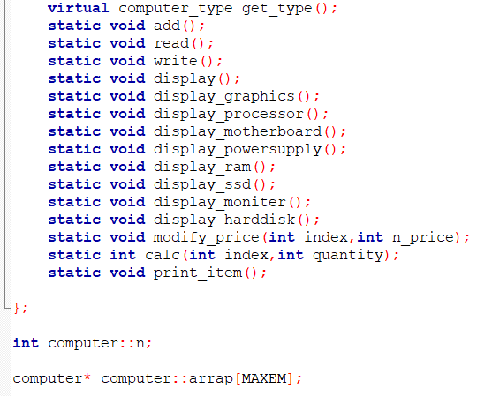
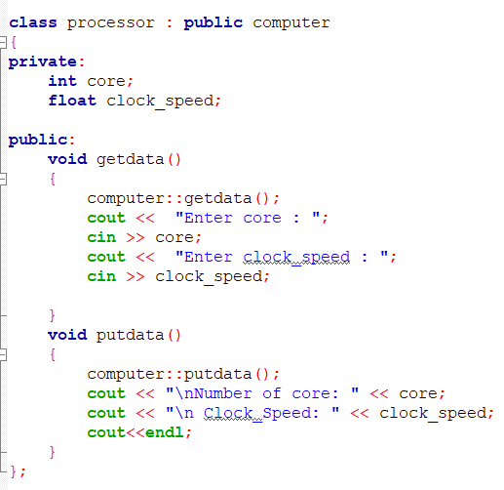
Functions and Features (Contd.)
A computer class is created which is used as the parent class for all the products of the shop.
The computer parts that are store in the shop for sell are inherited from the computer class with necessary attributes.
Here are some sample classes:

Slide 6
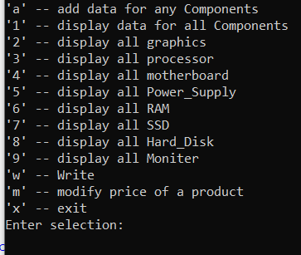
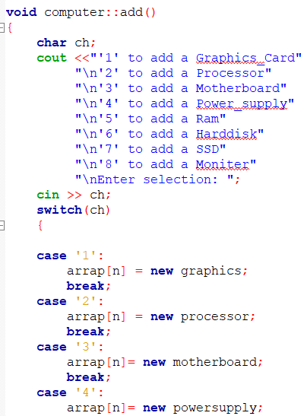
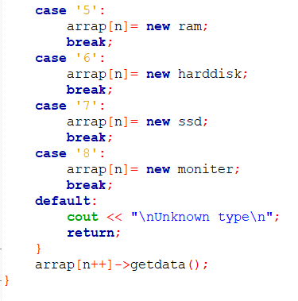
Functions and Features (Contd.)
When the manager logs in, a menu will come in front of him/her, asking for which operation to be performed.
If new product is to be added, memory is allocated for the object of the corresponding class and then data is taken input from the manager.
For displaying all products, 1st the type of the object is checked, i.e. from which class it is, then the data from the corresponding object is printed.
Product data are written to and read from a .txt file using file i/o system.

Slide 7
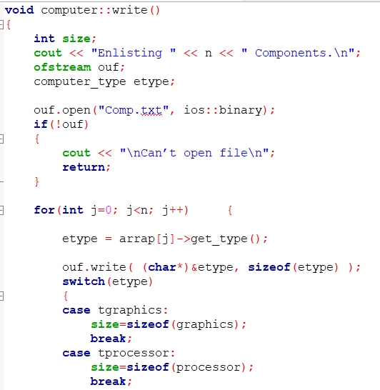
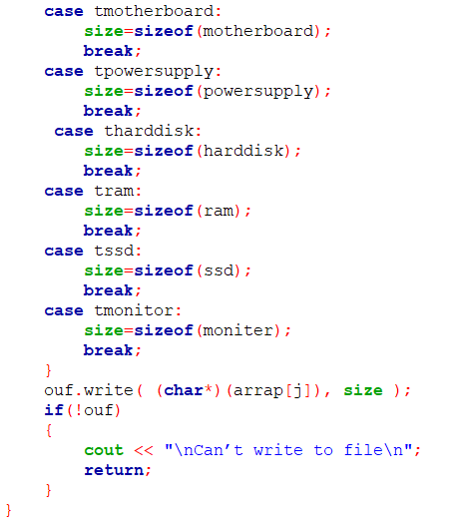
Functions and Features (Contd.)
Data Writing:
Type of the object is checked.
Size of the object is determined.
Data from the object written to file as characters.

Slide 8
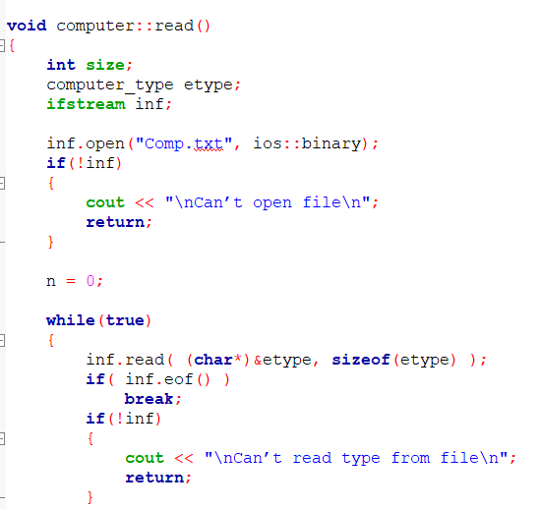
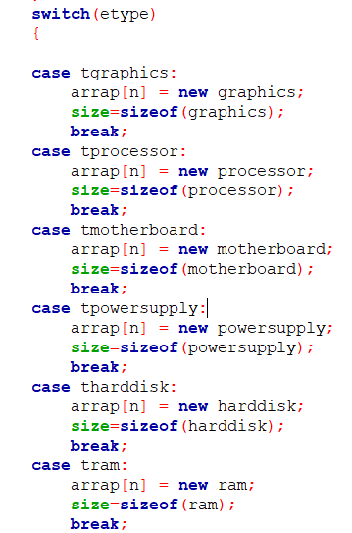
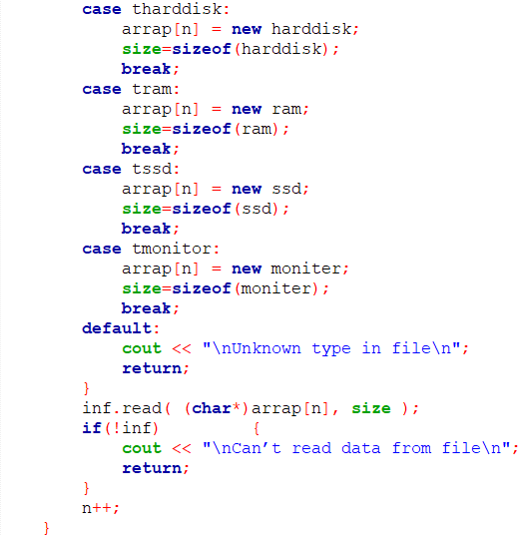
Functions and Features (Contd.)
Data Reading:
Type of object is determined.
Memory allocated for the corresponding class object.
Data from file are read as characters.

Slide 9
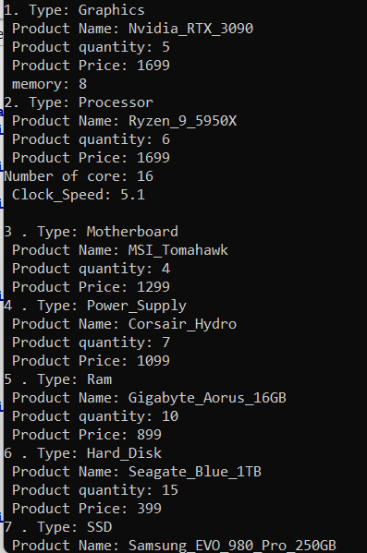
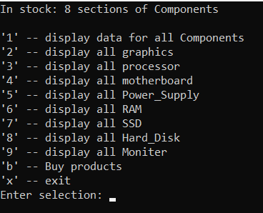
Functions and Features (Contd.)
In case of customer, a menu comes up to display various components, to buy products or to exit the program. Products can be viewed individually or all together.
Customer can buy one or multiple products from the available products.

Slide 10
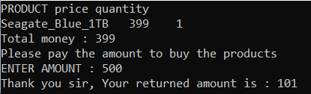
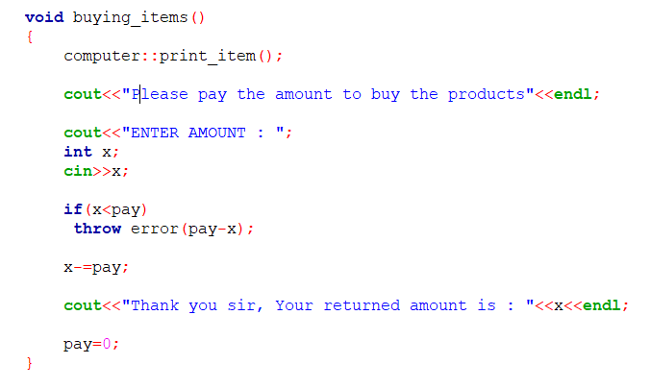
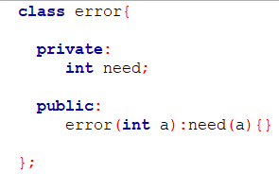
Functions and Features (Contd.)
When customer proceeds to check out, he will be shown all the products he’s purchasing and asked to input the amount of money to be paid. If paid more, the extra money will be returned.
There is an error handling mechanism for those who paid less than the required amount. In such cases the customer is kicked out of the program.

Slide 11
Future Extensions
Coupon system
PC building simulation
User account creation and management
Home delivery system

Slide 12


